Slide 1
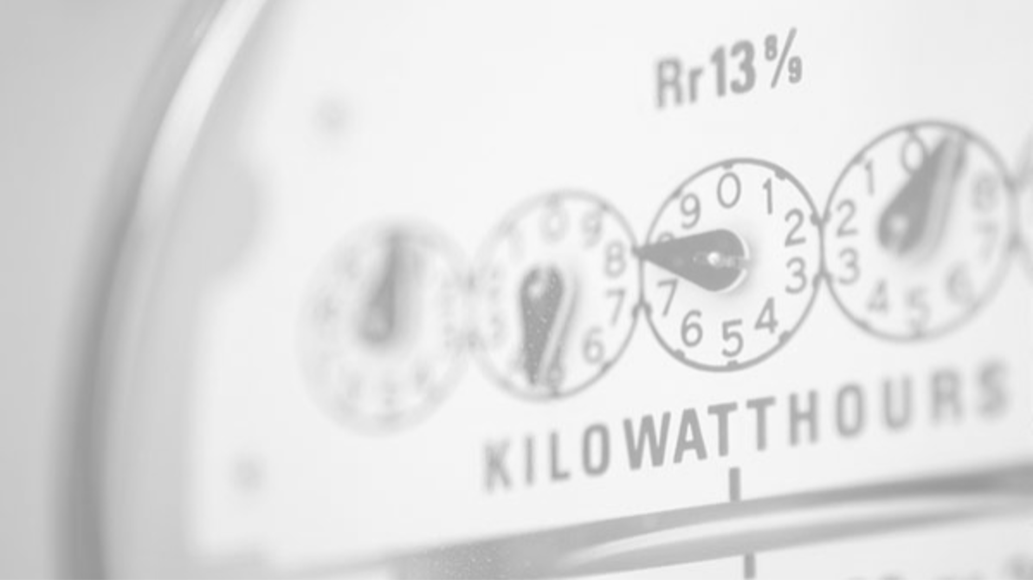
Time Series Submeter Usage
ANALYSIS
Michael Bauler 02.15.2021

Slide 2

GOALS
Primary: Build predictive models, visualize power usage of the residence & prove or disprove the clients claims.
Secondary: Report any additional insights the analysis has provided

Slide 3
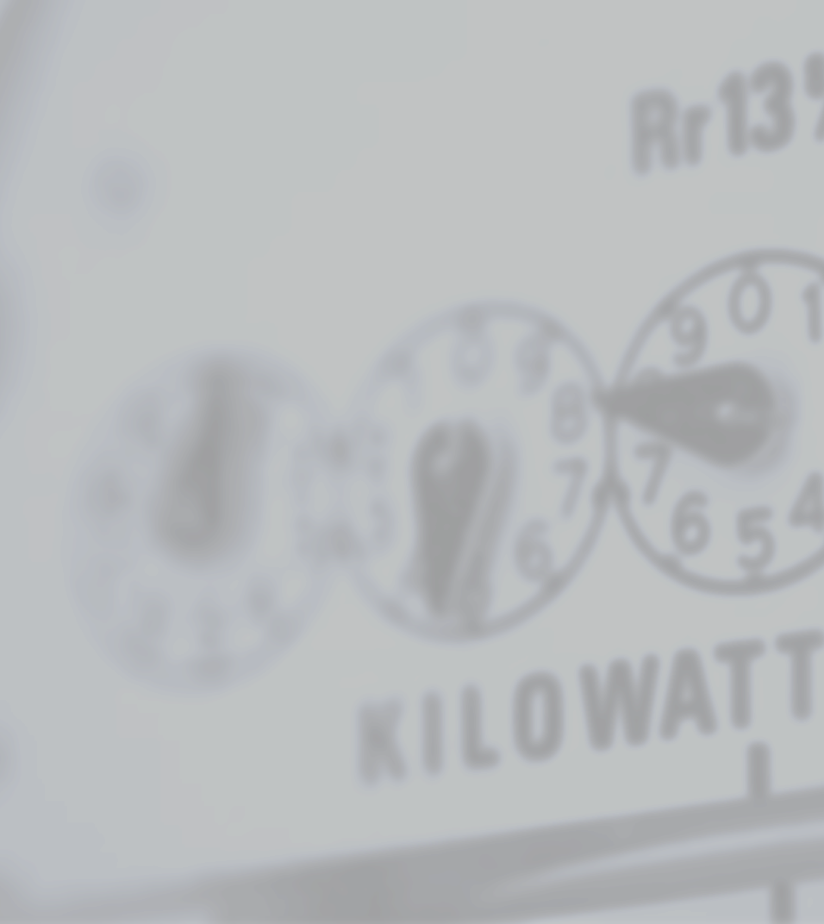
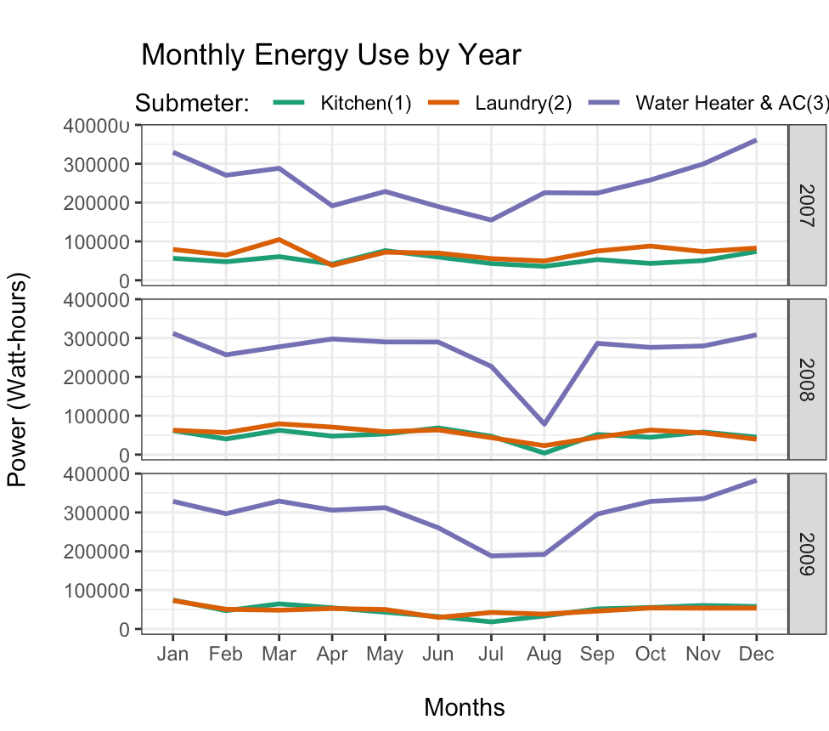
ANNUAL ENERGY USE 2007 - 2009
- OBSERVATIONS -
The Water & AC Submeter (3) consistently use the most energy across years
Seasonal patterns show a steady decline to reaching lows in the summer and peak energy usage in the winter months
August 2008 shows a sharp decline of all submeters

Slide 4

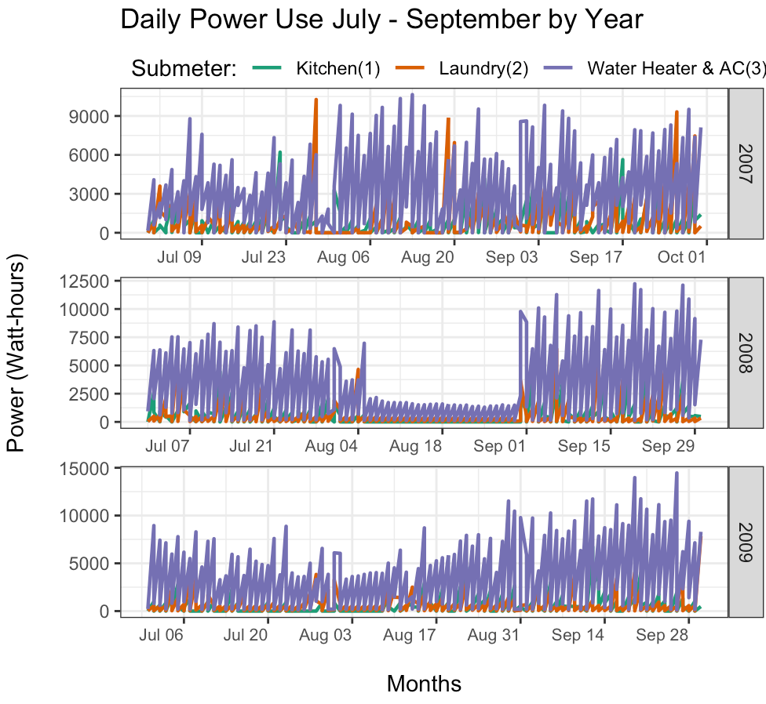
TYPICAL SUMMER ENERGY
The Steep ‘dip’ ONLY occurs in August 2008

Slide 5
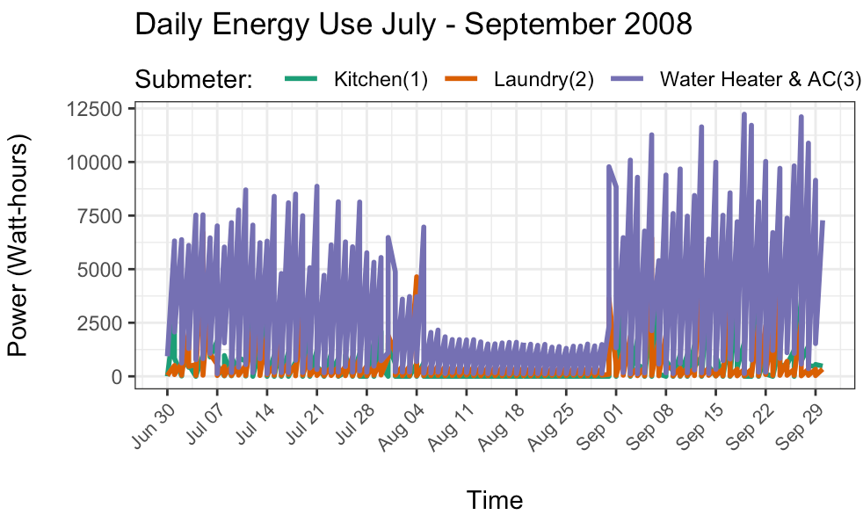
‘DIP’ IN SUMMER 08’ ANALYZED
- OBSERVATIONS -
Steep drop in energy usage occurs from Aug 5, 2008 – Sept 01, 2009
Water & AC still uses more energy than other submeters even during this time

Slide 6
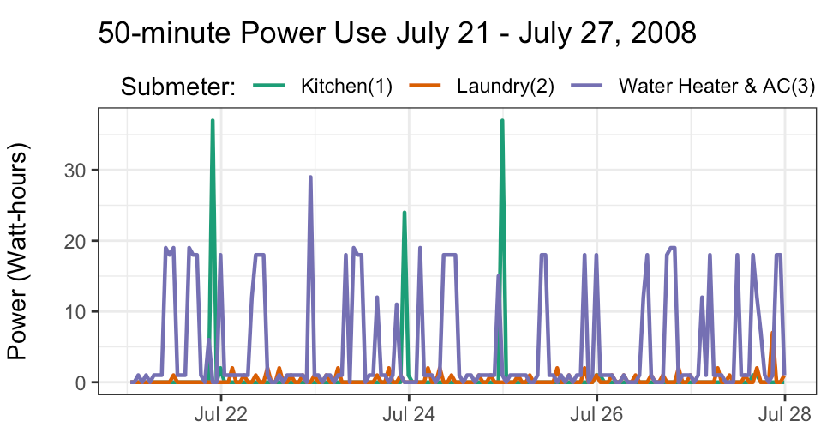
TYPICAL WEEK BEFORE THE ‘DIP’
- OBSERVATIONS -
Water & AC used consistently
Kitchen used a few times (22-37 watts)

Slide 7
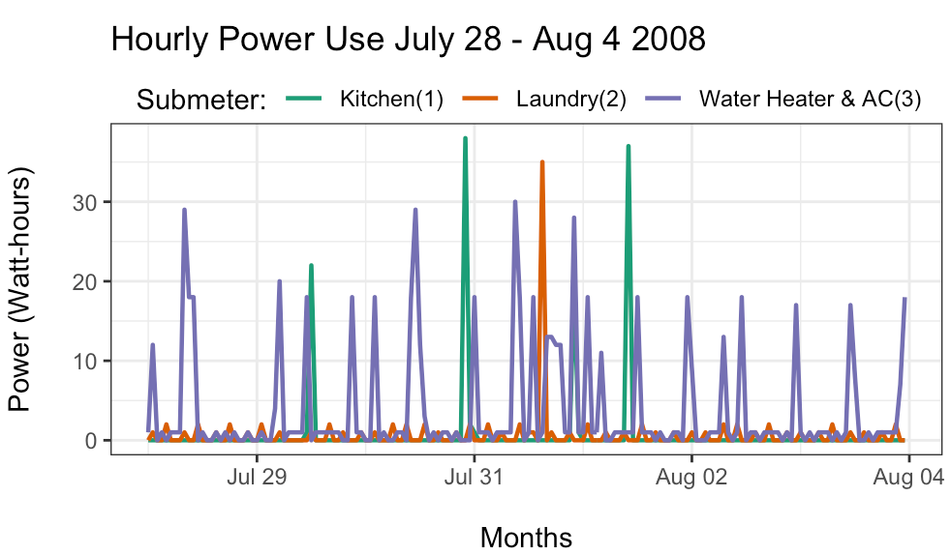
THE WEEK OF THE ‘DIP’
HOURLY POWER USE FROM JULY 28 – AUG 4, 2008
- OBSERVATIONS
Only WATER & AC used after Aug 02’
Kitchen used 4 times, (19-37 watts)
Laundry used once @ 35 watts, 2-3 watts all other times
Water and AC used more frequently (2-30 watts)

Slide 8
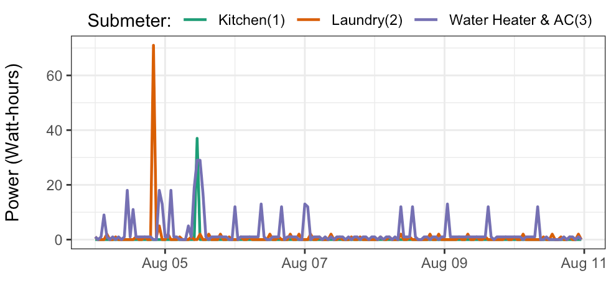
EXPLORING EACH WEEK IN AUGUST
- OBSERVATIONS -
Hourly use August 5TH – 11TH
Considerable drop of energy usage in after August 5th
AC & Water still shows spikes about once a day
Laundry used again on Aug. 5th

Slide 9
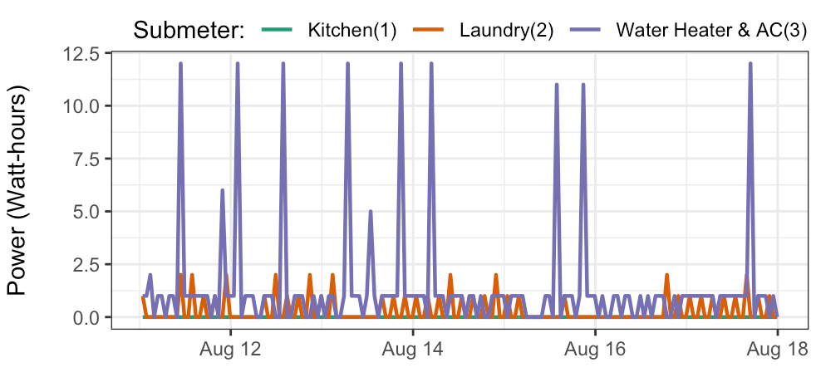
EXPLORING EACH WEEK IN AUGUST
Hourly use August 11TH – 18TH
- OBSERVATIONS -
Kitchen shows no usage
Laundry used a few time (less than 3 watts)
Water Heater & AC regular use intervals of 1 watt, spike of 12 watts once a day.

Slide 10
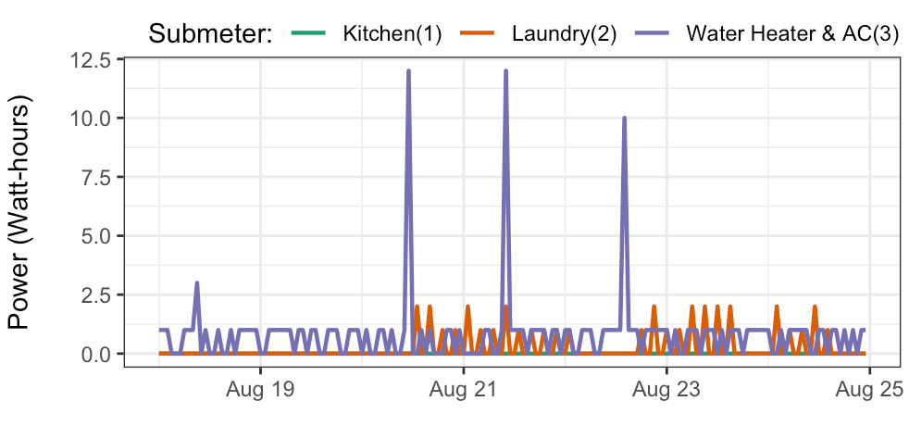
EXPLORING EACH WEEK IN AUGUST
Hourly use August 18TH – 25TH
- OBSERVATIONS -
Kitchen shows no usage
Laundry shows no usage on Aug 19th but used on following days
Water Heater & AC regular used @ regular intervals

Slide 11
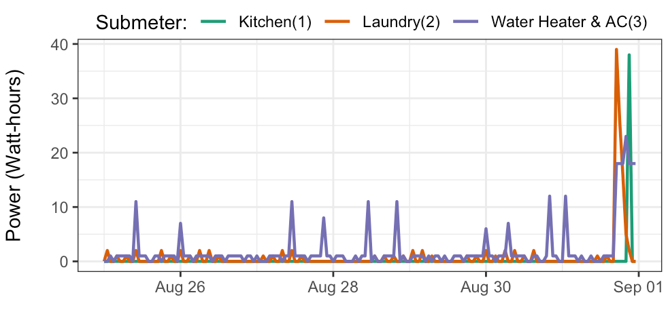
EXPLORING EACH WEEK IN AUGUST
August 26TH – September1st
- OBSERVATIONS -
Kitchen shows no usage until Sept 1
Laundry shows the same pattern as the prior week

Slide 12

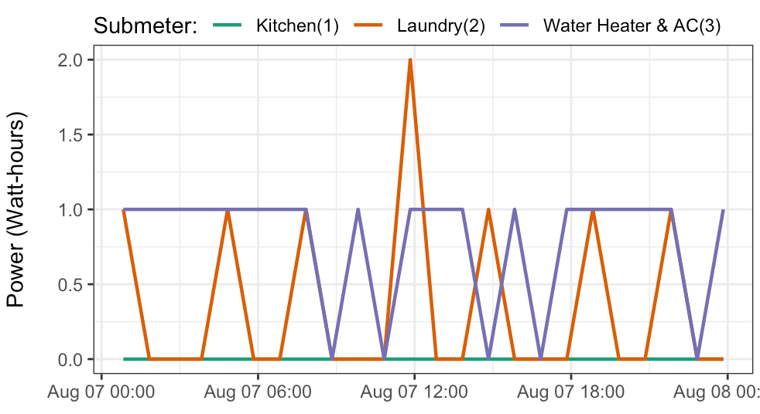
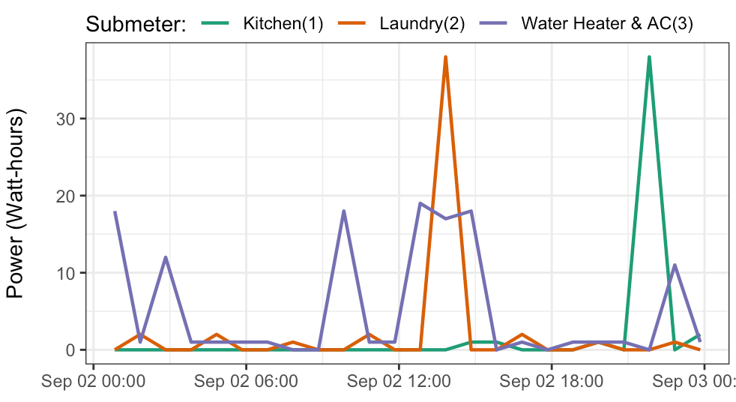
AVG DAY COMPARED TO DAY DURING ‘DIP’
Aug use ranges from 0 – 2 watts, Sept use ranges from 15-35 watts
Hourly usage on Aug 7, 2008
Hourly usage on Sept 1, 2008

Slide 13
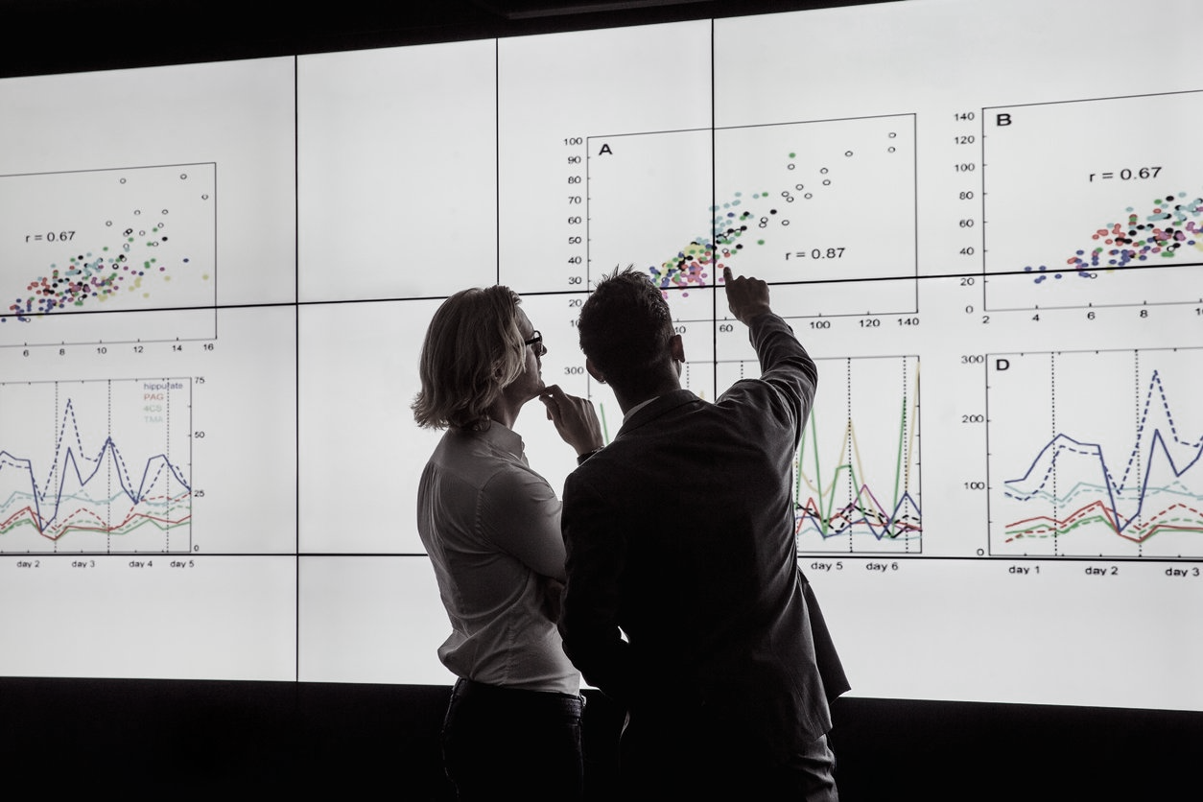

CONCLUSIONS/SUMMARY
‘DIP’ in Aug. 08 is atypical compared to all other time periods
No energy was used from the kitchen from Aug 6 – 31st, 2008
Water heater & AC is consistently used more Seasonal use patterns reveal peak energy use in winter
Extended decline (DIP) for all sub-meters seen Aug 6th - 31st, 2008
*The analysis highlights opportunity cost for the occupant to save money & energy simply by behavior modification
*The analysis shows noticeable time periods of peak usage – opportunity cost savings for the electric co.; to offer peak & off-peak rates
*Long term patterns can be used to predict future usage with potential to flag unusual consumption or appliance degradation

Slide 14

THE CLIENTS CLAIM IS VALID
Based on evidence from data, the residence was not occupied from August 6th - August 31st, 2008, but was occupied all other days within July-September

Slide 15
ANY QUESTIONS?
- Michael Bauler 02.15.2021

Slide 16
LESSONS LEARNED
How to obtain data using an SQL query
Now know submeters show individual energy usage & encourages behavior modification
Analyzing data with date and time is inherently challenging and requires extra steps i.e., Lubridate and POSIX

